Slide 1
Business Case 2
Classification – Supervised Learning
Bersani Michele
Corazza Lorena
Grignani Alessandro
Radaelli Gabriele
Schembri Salvatore

Slide 2
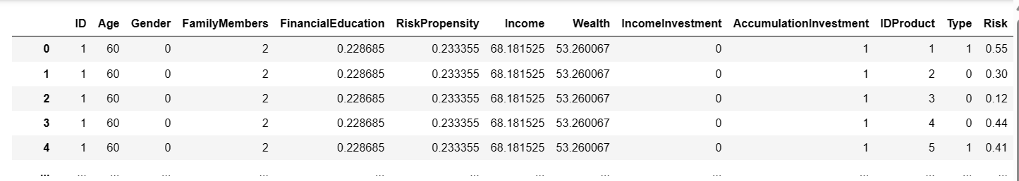
DATA PREPARATION
Immagine dei dati

Slide 3
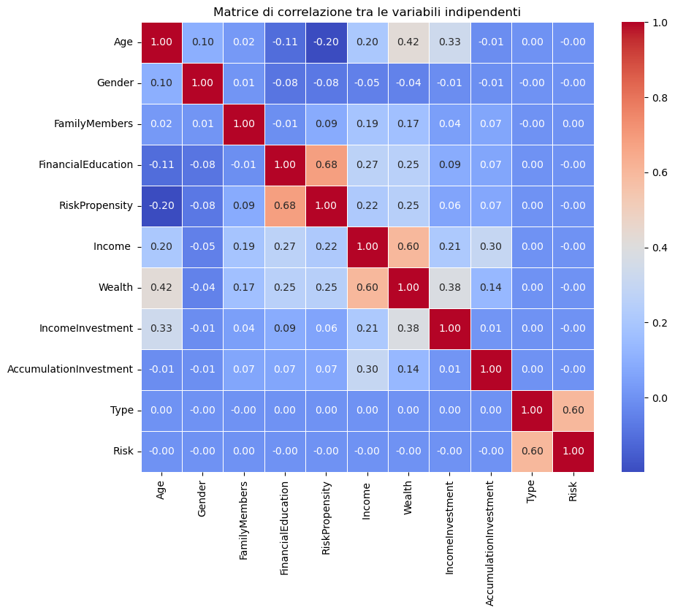
EXPLORATIVE ANALYSIS

Slide 4
ALGORITHM IDEAS FOR CLASSIFICATION
CLASSIFICATION TREE
RANDOM FOREST
LOGISTIC REGRESSION
QDA/LDA
SVM

Slide 5
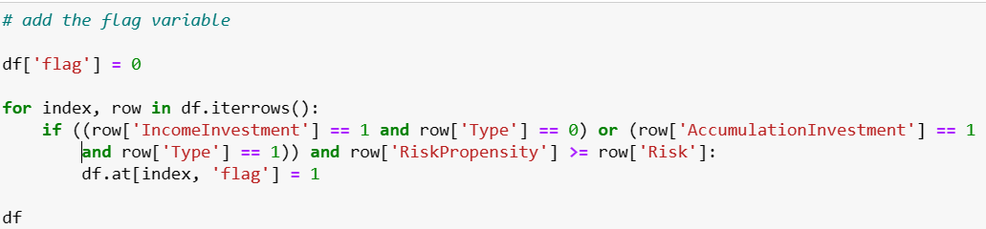
Inferring labels

Slide 6
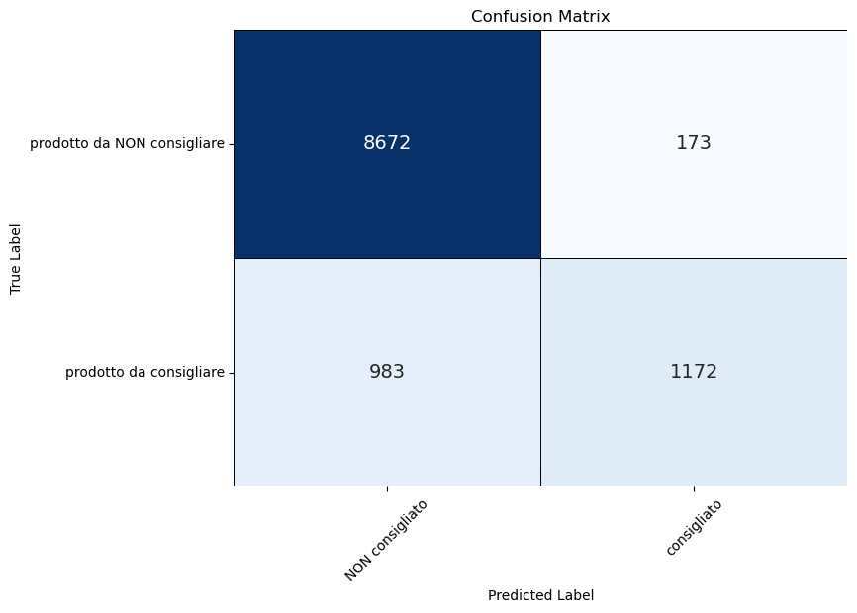
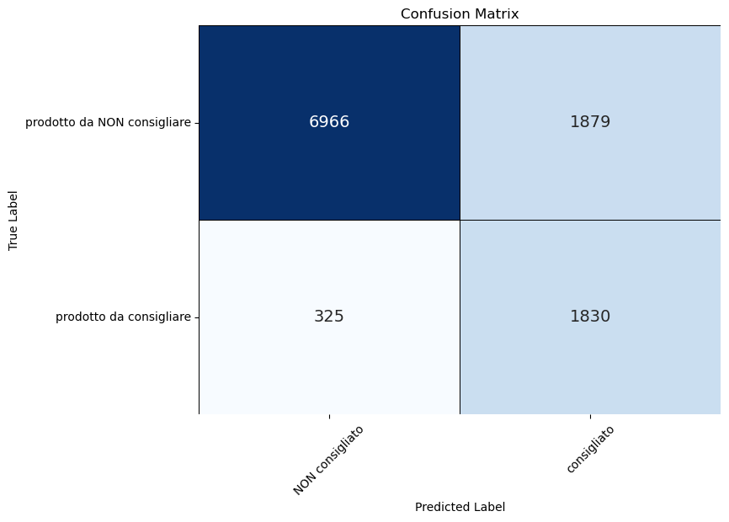
LOGISTIC REGRESSION
Without threshold
Without threshold
With threshold

Slide 7
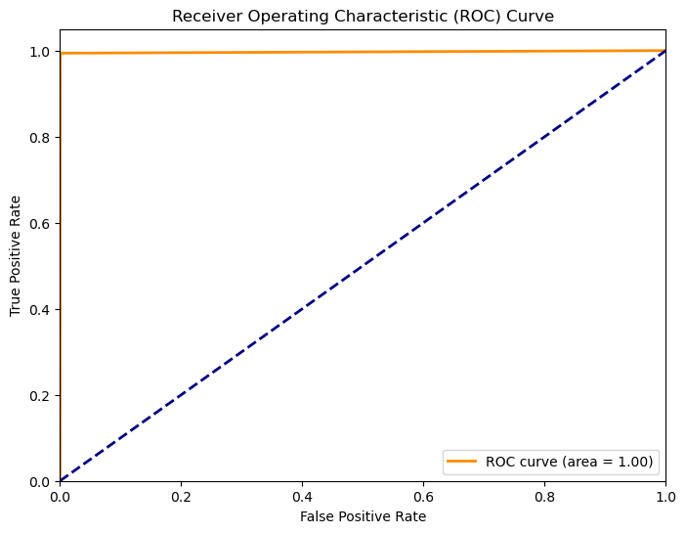
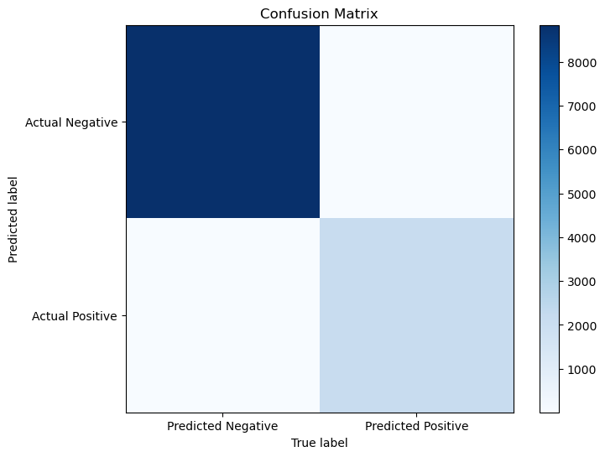
RANDOM FOREST
8840 5
13 2142

Slide 8
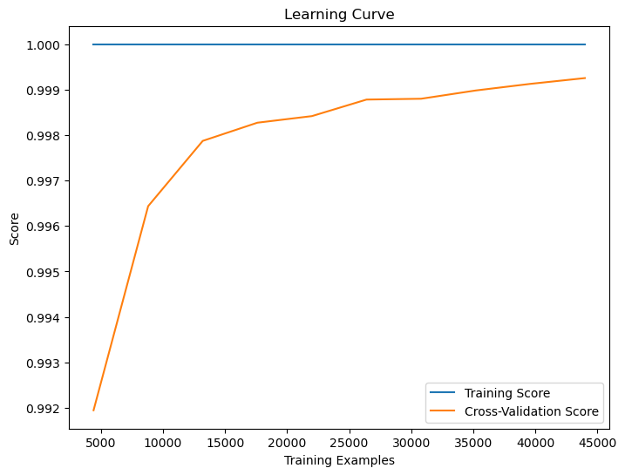
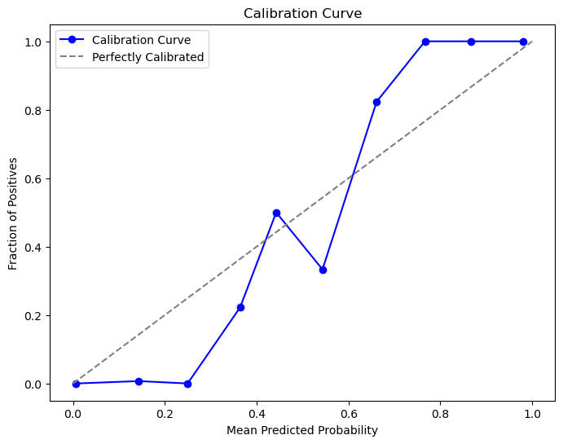
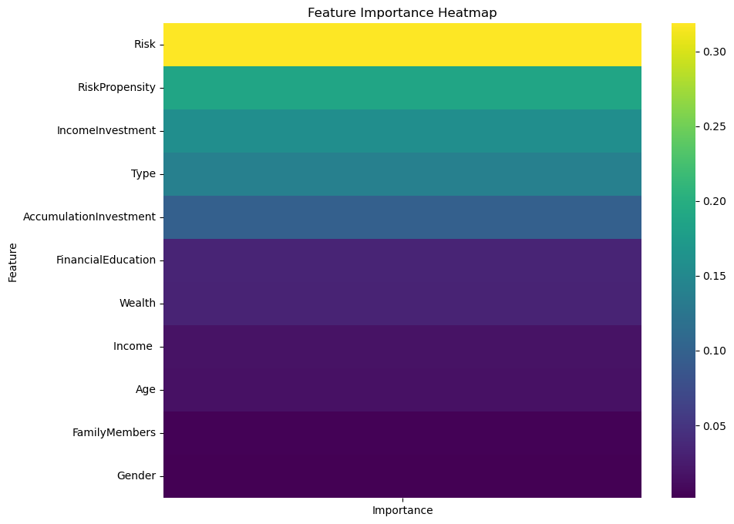
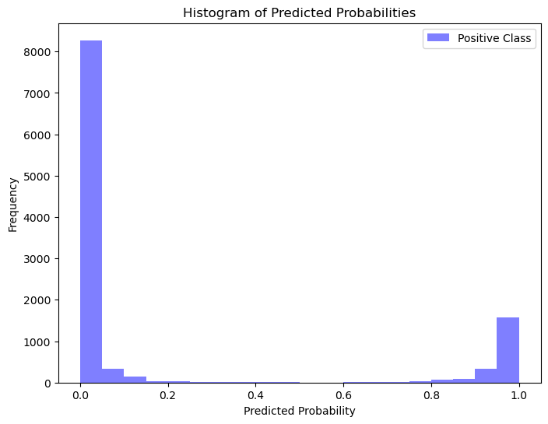

Slide 9
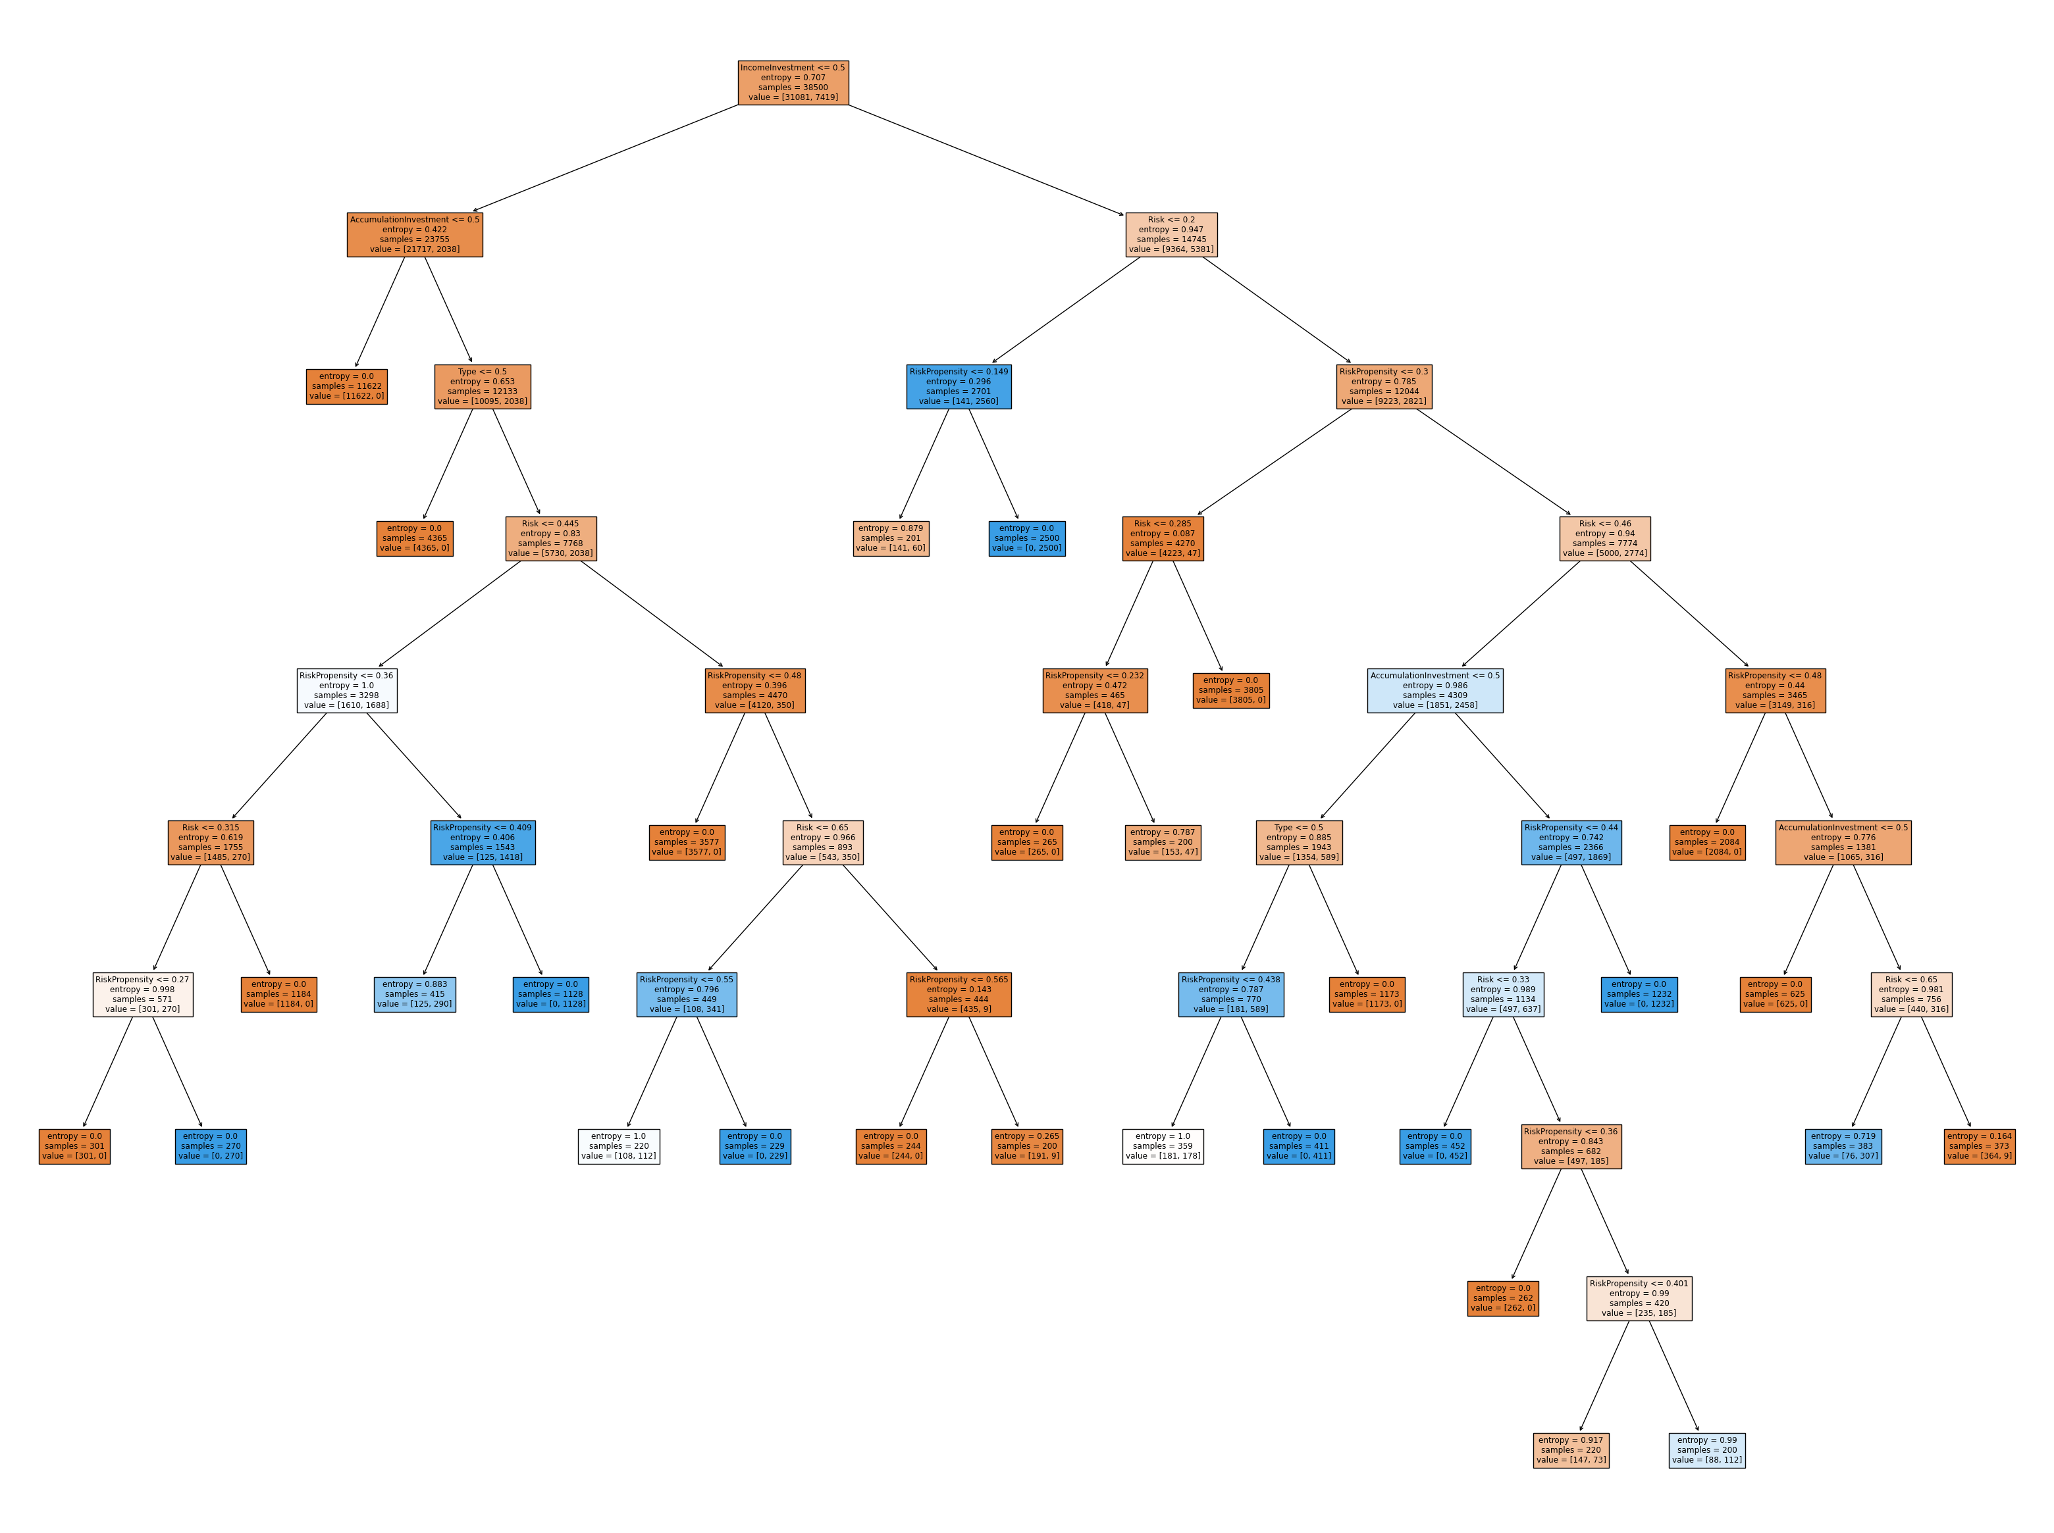
Decision tree

Slide 10
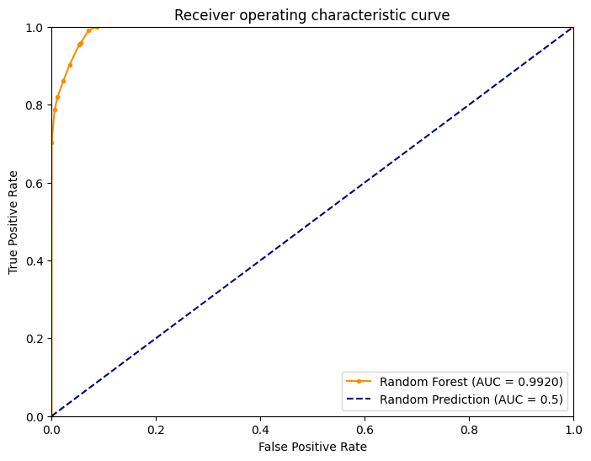
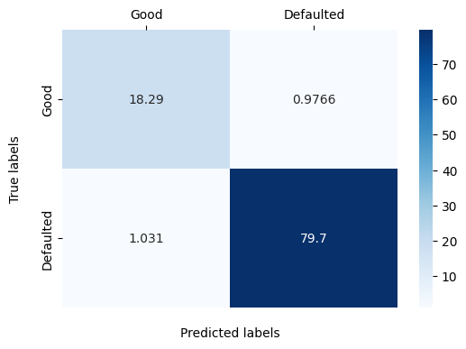
Decision tree - analysis

Slide 11
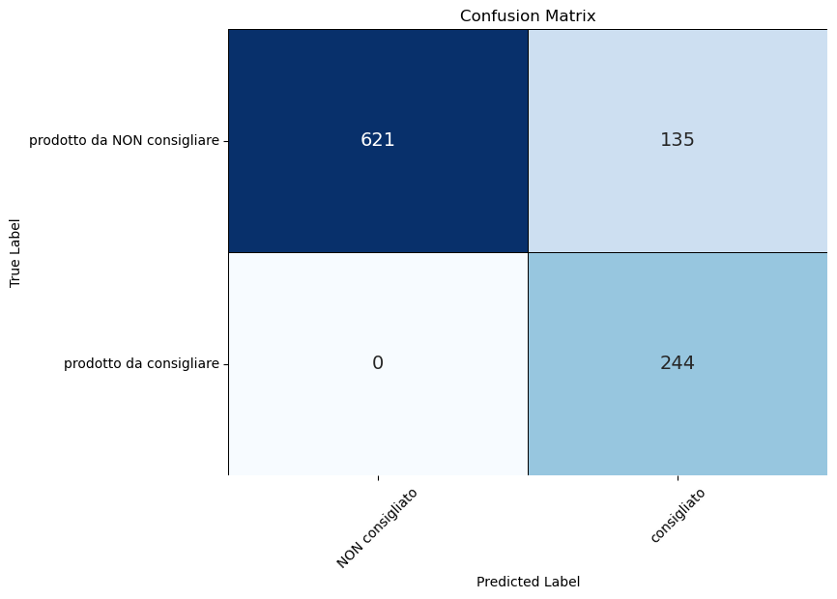
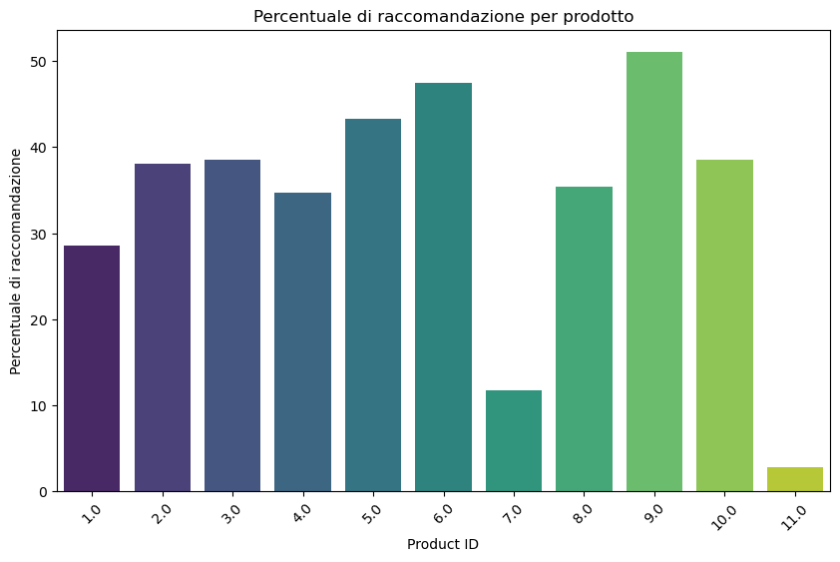
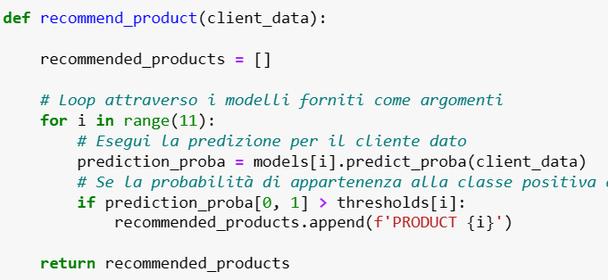
ALTERNATIVE
A reccomandation system based on 11 logistic classification
Very high precision in recognizing the products that should not be reccomended to the clients,
Less precision in the opposite case but when there is doubt the model lean to reccomend

Slide 12
IDEA TO CREATE THE LABEL
IDEA DELLA FORMULA PER LA LABEL / FLAG
FORMULA SEMPLICE
IDENTIFICAZIONE DEL CLIENTE MODELLO PER CIASCUN PRODOTTO => CALCOLO DELLA DISTANZA

Slide 13
IDEAL CLIENT IDEA
Finding the ideal client that minimises the distance between the common features of the product i (Risk, Type – RiskPropensity, AccInv/IncInv ).
After finding an ideal client for each product, we assign each client j the product ID i that corresponds to the ideal client i that minimises the distance between client i and client j .
After assigning each client a product we will use classification for each product i ( 1 if the product i was recommended to the client 0 otherwise) and then we will apply logistic regression.
We test the power of the algorithm.

Slide 14
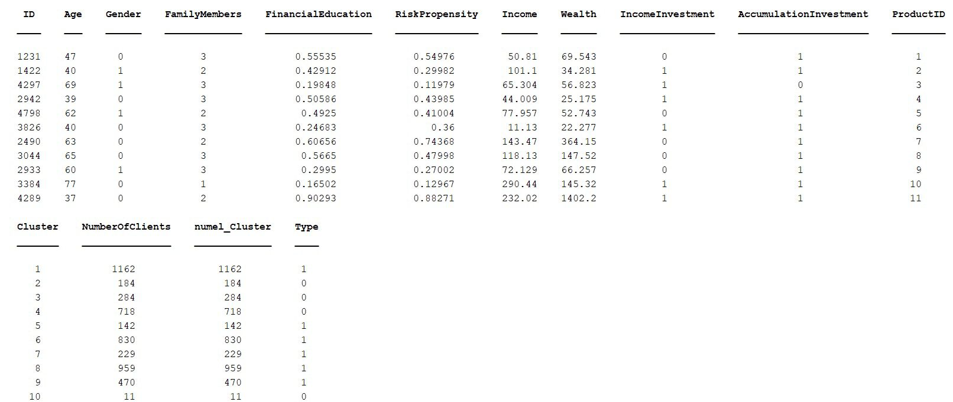
Features of each ideal client for different products

Slide 15
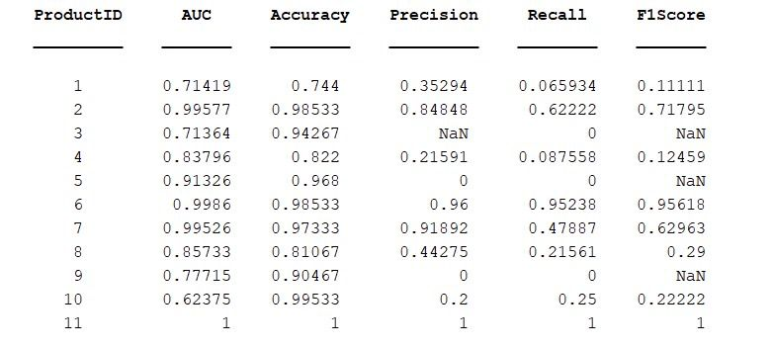
Logistic Regression for each product

Slide 16
COMMENTS ON THE MODELS
Commento sui modelli della classificazione: si poteva far meglio in che modo?

Slide 17
Some comments
Descizione dell’idea per la creazione delle label in maniera più approfondita
Eventuali percentili / distanze dai clienti ideali per prodotto

